Slide 1
Distributed Systems Client / Server Architecture Clustering

Slide 2
Distributed Systems
A Distributed System is made up of several processes running on separate machines that cooperate though the exchange of messages across a network.
In this section, we will describe distributed systems as…
Communicating processes that reside on separate machines.
Client-Server e.g. HTTP Servers with Client Browsers.
Clusters of Server Processes

Slide 3
Transmission Control Protocol (TCP) and Internet Protocol (IP)
TCP/IP is the network protocol that Runs the Web.
TCP/IP is two network protocols layered on each other.
IP protocol allows the exchange of unordered packets of data between two machines across the network.
The network “routes” packets from the sending to receiving machine.
TCP protocol provides an ordering mechanism that allows a process to receive the data in the same order as it was transmitted.
Sockets are provided by the TCP layer.
TCP/IP includes services that make the overall internet work.
DNS (Domain Naming Service) translates network names (google.com) into specific IP addresses (216.58.184.46).

Slide 4
TCP/IP Network Communications
Notes:
Use the utility traceroute (tracert) to list the routers between local PC and destination net address e.g. google.com.

Slide 5
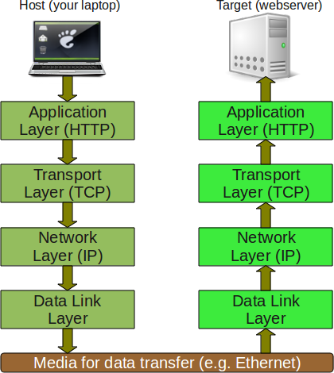
Operating Systems TCP/IP Network Stack
OS implements a network protocol as a stack of services.
The application on the top and the hardware on bottom.

Slide 6
OS Provides to an Application / Process …
The ability to lookup connection information to a network address.
The ability to establish a socket connection with a second process running on the TCP network.
The ability to reliably transmit a stream of bytes (messages) to a connected process.
The ability to listen for and accept bytes (messages) sent by a connected process.
The ability of either process to know when the other process has broken the connection.

Slide 7
Socket-Based Communication
The Socket is an Interprocess Communications Channel (IPC) between two cooperating processes.
Processes running on different machines.
Sockets allow two-way communications between these process.
Processes at each end of a connection can send streams of data to the other process.
A process can send & receive data to / from the other process.
TCP/IP guarantees that data is delivered to the receiving side of a connection in the same order it was written by the sender.

Slide 8
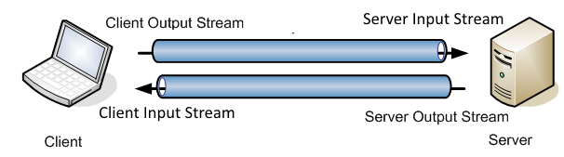
TCP Sockets
Each socket established two one-way byte steams / pipes between the two processes.
Each side’s output is the other side’s input stream
The client writes data to it’s output steam which is read by the server.
The client reads data from its input steam sent by the server.
Notes:
See Java’s InputStream and OutputStream classes.

Slide 9
Sockets and Blocking I/O
A process / thread listens for messages (data) sent by the process at the other end of the socket connection.
Examine the read() operation from the Java’s InputStream.
Examine the write() operation from the Java’s OutputStream.
When a process / thread reads() from a socket’s empty InputStream, the thread will block until the other process writes() data to its OutputStream.
This is how threads synchronize the exchange of messages between the two processes.

Slide 10
Server-Side Request-Response Message Processing with Sockets
// Accept() blocks until a client requests connection
Socket socket = serverSocket.accept();
InputStream ipStream = socket.getInputStream();
OutputStream opStream = socket.getOutputStream();
while(true) {
// Blocking Read Operation
String request = ipStream.readLine(); // Blocking
String response = processMessage(request);
opStream.writeLine(response);
}

Slide 11
Client / Server Communications
A very common distributed systems architecture is the client-server design pattern.
Based on the exchange of request / response messages.
Client is the process that sends the server a request message and waits for the server’s response message.
Server is the process that listens for arriving request messages.
Each message is a request for the server process to perform some application-specific operations.
The operation results in a response message containing the results of the requested operation.

Slide 12
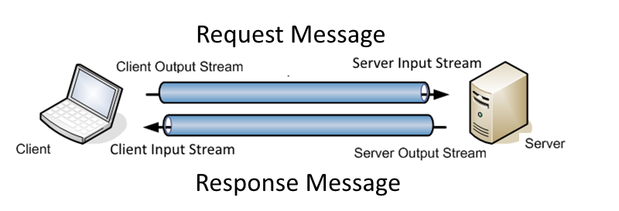
Client-Server Distributed Architecture
The Client sends the Server a Request Message and blocks waiting for the Server’s Response Message.

Slide 13
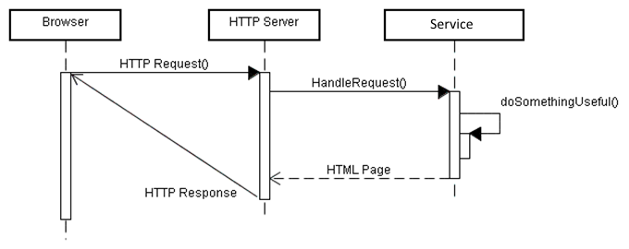
Client-Server Messaging is Synchronous
Synchronous in that the client’s execution blocks until a response is received from the server.
A browser (client) makes a request for a HTML page from the server and blocks waiting for the server to respond.

Slide 14
Client - Server interaction across a network is based on Sockets
Typical synchronous message exchange follows these steps:
1. The server is running and waiting to accept incoming connection requests.
2. Client obtains the IP network address of the server.
2. Client requests and establishes a socket connection from the server.
3. Client sends a request message to the server and blocks waiting for the server’s response.
4. The server receives and processes the request, producing some information.
5. The server sends a response message containing the needed information back to the blocked client across the socket.
6. The client received the message, unblocks, and continues processing with the response information.
The client thread blocks waiting for the response message.

Slide 15
Clients connect to Servers installed at a specific network address and port number.
Network services are provided by servers installed at network addresses and ports.
TCP/IP (V4) addresses are four part e.g. Google’s is 74.125.45.100
The address identifies a network-connected node / machine.
Each network-connected machine can host multiple ports.
Ports are numbered 0-65,535.
Servers “listens” for client connection requests for specific ports.
So a machine can host several services / servers.
A browser connects to an address and port.
Typically, HTTP Web Servers are installed at port 80.
For example google.com is at: http://74.125.45.100:80/

Slide 16
Establishing the Server Process in Java
Java provides the class ServerSocket.
ServerSocket listens for connection requests from clients.
ServerSocket.accept() blocks until a client requests a connection, and then establishes a new socket connection between the server and client processes.
ServerSocket serverSocket = new ServerSocket(10023);
Socket clientSocket = serverSocket.accept(); // Blocking
inputStream = clientSocket.getInputStream();
outputStream = clientSocket.getOutputStream();
// ... Read request from InputStream
// ... Write response to OutputStream
inputStream.close();

Slide 17
Establishing the Client’s Connection
Java provides the class Socket which connects to the IP address and port number of the listening service.
The service must be running / listening before the client request.
byte byteAddr[] = {127, 0, 0, 1}; // Server Address
InetAddress address = InetAddress.getByAddress(byteAddr);
SocketAddress saddr = new InetSocketAddress(address, 10023);
Socket socket = new Socket();
socket.connect(saddr); // Connects to server
InputStream inputStream = socket.getInputStream();
OutputStream outputStream = socket.getOutputStream();
// ... Write request to OutputStream
// ... Read response from InputStream
inputStream.close();

Slide 18
Server’s Request Message Processing Loop
The server process repeats the process of
Accept Socket Connection from Client Process
Read Request Message from Socket
Build and writes Response Message to Socket
Close Connection
while (true) {
Socket clientSocket = serverSocket.accept();
inputStream = clientSocket.getInputStream();
outputStream = clientSocket.getOutputStream();
Handler handler = parseRequest(inputStream);
handler.run(inputStream, outputStream);
inputStream.close();
}

Slide 19
Building & Processing Messages
Sockets only provide pipes through which streams of bytes can reliably be exchanged between two processes.
No support for determining the structure of the messages.
The application (client & server) must agree upon the format of the request and response messages carried in the streams.
The request message contains the information needed by the server to understand what is being requested by the client.
The response message contains the information needed by the client.

Slide 20
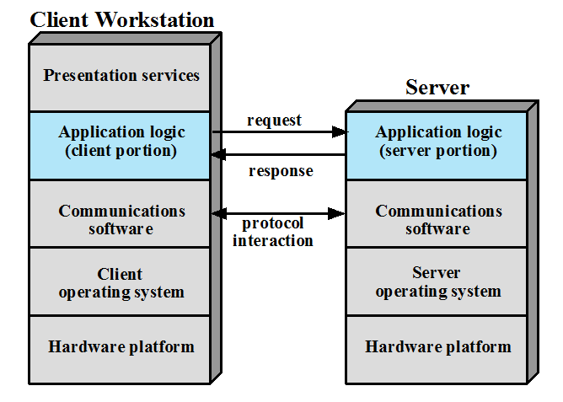
The Request / Response Messages are established by the Application Logic
Notes:
The key feature of a client/server architecture is the allocation of application-level tasks between clients and servers. Figure 16.2 illustrates the general case.

Slide 21
Client Requests a Service from Server
Suppose the server is capable of providing multiple services.
The request message must first specify which services (operation) is being requested by the client.
Following any additional information needed by the service to execute the operation.
The request message format might be:
operationName\n
argument1\n
argument2\n
Where the number of arguments depends on the requested operation.
Notes:
\n represents an ASCII new-line character. (0X0A)

Slide 22
Parsing the Message Format
From the previous example we saw that the client’s message…
Contains multiple sections i.e. operation ID and multiple arguments.
Has a method of separating one section from the other e.g. a newline delimiter between sections in the example (\n).
The server process receiving a message must be able to parse the sections from the byte stream.
The server must first determine which of several operations is being requested before it can parse the remaining message sections.
The client has it easy… It knows which request was sent so can anticipate the format of the response message.

Slide 23
Server Message Handling
The request message contains an Operation ID in the its first section.
The server first reads the Operation ID and can determine how to parse the remainder of the request message.
On the next slide, the parseRequest() method…
Reads the first section of the message containing the Op ID.
Creates and returns the appropriate message handler.
The operation-specific handler ‘knows’ how to extract the remaining request sections / arguments.
And how to build the response needed by the client.

Slide 24
while (true) {
Socket clientSocket = serverSocket.accept();
...
Handler handler = parseRequest(inputStream);
handler.run(inputStream, outputStream);
...
}
Handler parseRequest(InputStream inputStream)
{
String commandString = inputStream.readLine();
if ("echo".equalsIgnoreCase(commandString)) {
Handler handler = new EchoHandler();
return handler;
}
else if ("reverse".equalsIgnoreCase(commandString)) {
Handler handler = new ReverseHandler();
return handler;
}
else {
// Handle unknown request error
}
}

Slide 25
Reverse Operation Handler Class
public class ReverseHandler
{
public void run(inputStream, outputStream)
{
// Read string to reverse from inputStream
String inMessage = inputStream.readLine();
// Write response on outputStream
String outMessage = reverse(inMessage) + "\n";
outputStream.write(“ok\n”);
outputStream.write(outMessage);
}
private String reverse(String data)
{
// Reverses string data and return.
return data.reverse();
}
}

Slide 26
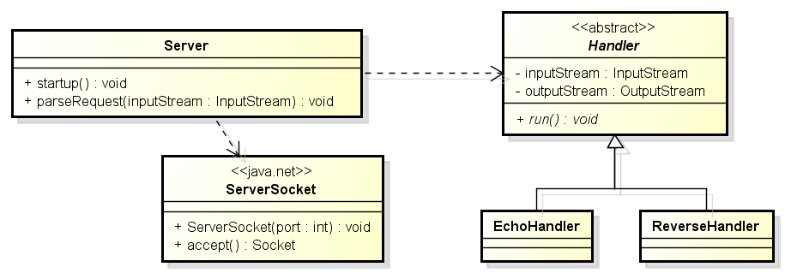
Design of the Sample Service
The sample code provided with the project gives the basic design of these server and message handling classes.

Slide 27
Three Tier Software Architecture
Three-Tiered is an software architectural pattern that describes how to design web application that include a remote GUI.
Typically, a user interface implemented as an Android app.
A Three-Tier Software Architecture divides its service implementations into three tiers / categories of objects.
Presentation: Application, HTML / JavaScript, other technologies.
Application: Services that implement business processes and business rules. Controllers.
Data: Services that implement the persistence of data (objects) in databases. Object-Relation Mapping.

Slide 28
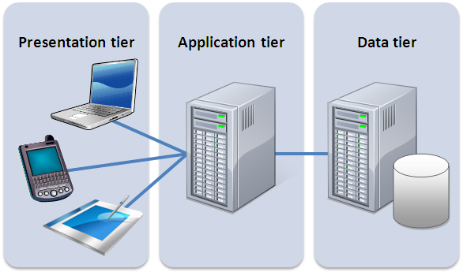
Each tier is often implemented on separate machines and communicate with each other via a network protocol.
This architecture lends itself to clustering techniques that increase performance and availability.

Slide 29
Clusters
A Cluster is a group of interconnected systems working together as a unified computing resource.
Clustering is an approach to building systems that provide scalable performance and high availability.
Scalable in that the performance of a clustered system can be increased by adding additional machines / processors.
Availability in that when multiple machines provide services, some of the machines can fail but the system continues to operate.

Slide 30
Example
A Web Service that is installed on a system that receives and processes incoming HTTP client request from across the internet.
A machine capable of processing 100 client requests per second.
As the service becomes popular, the number of client requests grows beyond a single machine’s capacity.
How can we increase the capacity of our service beyond the limitations of a single machine?
The reliability of our service is questionable because the machine is a single point of failure.

Slide 31
Load Balanced Clusters
Load Balanced Clustering is a technique that provides both system performance scaling and availability.

Slide 32
Load Balanced Clusters
Each of the application servers hosts the same application(s).
Each server is capable of processing any of the client’s requests.
The Load Balancer is responsible for receiving a client’s request and forwarding to one of the cluster’s servers.
The LB might forward each request to each server in a round-robin fashion, or to the least-loaded server.
The Load Balancer is capable of detecting when one of its managed servers has failed and removes it from the cluster.

Slide 33
Scaling and Performance
We can add additional servers to the cluster increasing the overall capacity of the cluster.
Performance scales according to the critical sections in the service implementation. See Amdahl's Law.
In the example, each server shares a single DBMS which becomes the shared resource in the concurrent execution.

Slide 34
High Availability
The service continues to operate even when one of its servers / components fails.
If any of the server’s fails, the Load Balancer detects the failure and stops sending it client requests.
However from the client’s perspective, the service is available as the remaining cluster servers continue to service client requests.
The failed server can be restarted and rejoin the cluster.

Slide 35
Benefits of Clusters
Incremental Scalability
Configured in such a way that it is possible to add new systems to the cluster in small increments.
High Availability
Failure of one node is not critical to system.
Notes:
• Incremental scalability: A cluster is configured in such a way that it is possible to add new systems to the cluster in small increments. Thus, a user can start out with a modest system and expand it as needs grow, without having to go through a major upgrade in which an existing small system is replaced with a larger system.
• High availability: Because each node in a cluster is a stand-alone computer, the failure of one node does not mean loss of service. In many products, fault tolerance is handled automatically in software.

